Slide 1
Unit Testing {
Class.java
ClassTest.java
[Oleh Ahmad Zein Haddad]
}
Unit Testing

Slide 2
Table Of ‘Contents’ {
01
02
03
Class.java
ClassTest.java
Konsep Unit Testing
Test-Driven Development
Contoh dengan JUnit
}
Unit Testing

Slide 3
01 {
[Konsep Unit Testing]
Class.java
ClassTest.java
}
Unit Testing

Slide 4
Definisi Unit Testing: {
Class.java
ClassTest.java
‘Unit Testing adalah suatu jenis software testing yang dilakukan untuk menguji suatu komponen/kelas software secara terisolasi’,
‘Tujuan unit testing adalah untuk memastikan bahwa setiap unit kode sudah bekerja dengan benar dan mengembalikan output sesuai harapan’,
‘Biasanya unit test dibuat menggunakan framework testing sehingga testing dapat dijalankan secara otomatis’,
}
Unit Testing

Slide 5
Manfaat ‘Unit Test’ {
Class.java
ClassTest.java
Instant Feedback
Mempermudah Refactor
Berfungsi sebagai Dokumentasi
Membantu memperbaiki bug
}
Unit Testing
Notes:
Unit Tests give you instant visual feedback, we all like the feeling of all those green lights when we've done. It's very satisfying. It's also much easier to pick up where you left off after an interruption because you can see where you got to - that next red light that needs fixing.
Unit Tests allows you to make big changes to code quickly. You know it works now because you've run the tests, when you make the changes you need to make, you need to get the tests working again. This saves hours.
Kegunaan kelas jadi diketahui karena kita tau ekspektasi output saat diberi input tertentu.

Slide 6




Framework ‘Unit Testing’{
Class.java
ClassTest.java
Java
PHP
< JUnit >
< PHPUnit >
Javascript
Python
< Jest, Mocha >
< standard library >
}
Unit Testing

Slide 7
02 {
[Test-Driven Development]
Class.java
ClassTest.java
}
Unit Testing

Slide 8
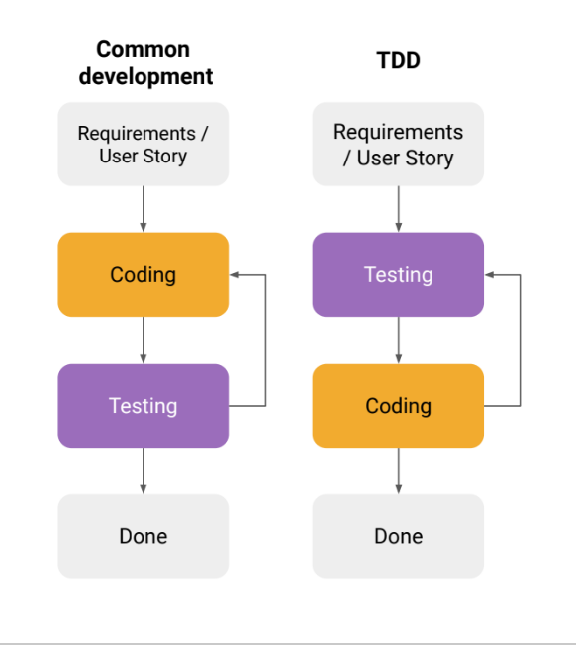
Definisi Test-Driven Development {
Class.java
ClassTest.java
‘Test Driven Development (TDD) adalah pengembangan yang mengacu pada testing sebelum melakukan proses coding’
}
Unit Testing

Slide 9
Kelebihan ‘TDD’ {
Class.java
ClassTest.java
Target output lebih objektif
Kinerja developer lebih terpantau
Membantu mencari bagian kode yang menyebabkan bug
Dan seluruh kelebihan unit testing
}
Unit Testing
Notes:
Having to think about a test makes one consider what the code is supposed to do: what the pre-conditions and post-conditions are, which functions are primitive and which are composed of primitive functions, what the minimal necessary public interface is, and what's an implementation detail.
Progress projek lebih jelas terlihat.

Slide 10
Kekurangan ‘TDD’ {
Class.java
ClassTest.java
Memakan waktu
Program akan menjadi lebih kompleks
Tidak efektif untuk program dengan requirements sering berganti
}
Unit Testing

Slide 11
03 {
[Contoh Unit Testing dengan JUnit]
Class.java
ClassTest.java
}
Unit Testing

Slide 12
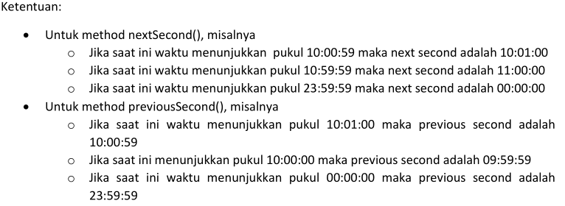
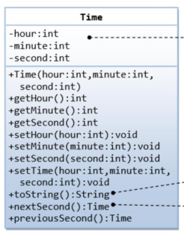
Kelas ‘Time’ {
Class.java
ClassTest.java
}
Unit Testing

Slide 13
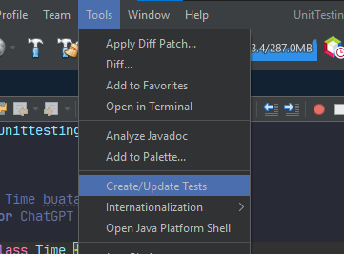
Class.java
ClassTest.java
Unit Testing

Slide 14
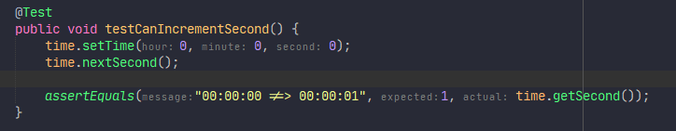
Class.java
ClassTest.java
Unit Testing

Slide 15
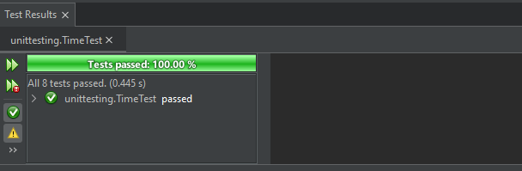
Class.java
ClassTest.java
Unit Testing

Slide 16
Terima Kasih
Class.java
ClassTest.java
Unit Testing

